Slide 1
Virus ,bacteriophage ,prion ,viroid, viral characteristics and replication
BY
Dr. Hesnaa Saeed Al-Mossawi

Slide 2
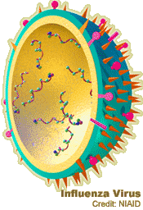
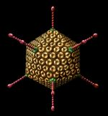
The virus

Slide 3
Virus
A virus is a non-cellular particle made up of genetic material and protein that can invade living cells.
Capsid: The protein shell, or coat, that encloses the nucleic acid genome.
Capsomeres: Morphologic units represent clusters of polypeptides,
Envelope: A lipid-containing membrane that surrounds some virus particles. It is acquired during viral maturation by a budding process through a cellular membrane
Virus-encoded glycoproteins are exposed on the surface of the envelope. These projections are called peplomers.
Nucleocapsid: The protein–nucleic acid complex representing the packaged form of the viral genome.
Structural units: The basic protein building blocks of the coat. Is referred to as a protomer.

Slide 4
Viral characteristics
Non living structures
Non cellular
Contain a protein coat called the capsid
Have a nucleic acid core containing DNA or RNA
Capable of reproducing only when inside a HOST cell
Some viruses are enclosed in an protective envelope
Some viruses may have spikes to help attach to the host cell
Most viruses infect only SPECIFIC host cells

Slide 5
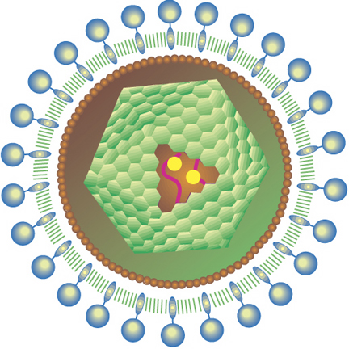
Viral characteristics …..con
Viral capsids (coats) are made of individual protein subunits
Individual subunits are called capsomeres
Outside of host cells, viruses are inactive
Lack ribosomes and enzymes needed for metabolism
Use the raw materials and enzymes of the host cell to be able to reproduce
Some viruses cause disease
Smallpox, measles, mononucleosis, influenza, colds, warts, AIDS, Ebola
Some viruses may cause some cancers like leukemia

Slide 6
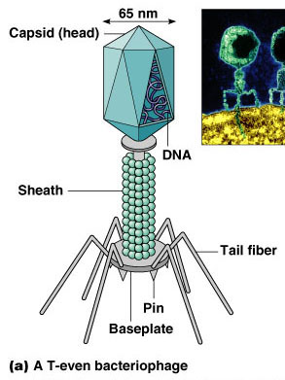
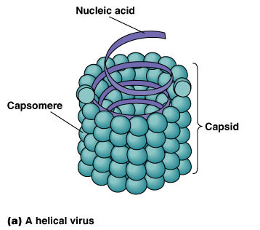
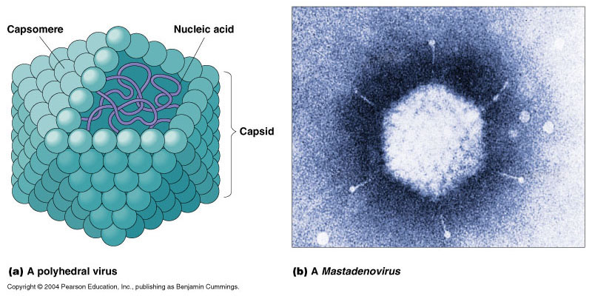
Viral shapes
Some may be helical shape like the Ebola virus
Some may be polyhedral shapes like the influenza virus
Others have more complex shapes like bacteriophages

Slide 7
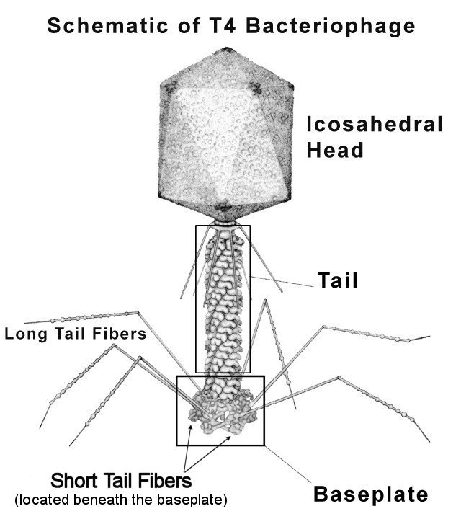
Bacteriophage
Viruses that attack bacteria are called bacteriophage or just phage
T-phages are a specific class of bacteriophages with icosahedral heads, double-stranded DNA, and tails
Six small spikes at the base of a contractile tail are used to attach to the host cell
Head with 20 triangular surfaces
Capsid contains DNA
Head & tail fibers made of protein

Slide 8
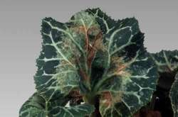
Viroid
Small, circular RNA molecules without a protein coat
Infect plants
300-400 nucleotides long
closed, folded 3 D shape

Slide 9
Prion
are Small proteinaceous infectious particles “infectious proteins”
They are normal body proteins that get converted into an alternate configuration by contact with other prion proteins
They have no DNA or RNA
The main protein involved in human and mammalian prion diseases is called “PrP”
Prions form insoluble deposits in the brain
Causes neurons to rapidly degeneration.
Mad cow disease (bovine spongiform encephalitis: BSE) is an example

Slide 10
Viral replication
1) Attachment: binding sites must match receptor sites on host cell
2) Penetration: endocytosis occurs and entire virus enters cell
3) Uncoating: separation of the viral genome from the capsid
4) Biosynthesis *genome replication *transcription *translation
5) Maturation: virus particles assembled
6) Release: lysis or budding

Slide 11
