Slide 1
Inoculation of clinical sample in embryonated egg and in laboratory animals
By
Dr. Hesnaa Saeed Al-Mossawi

Slide 2
Inoculation of clinical sample in embryonated egg
Routs:
Chorioallantoic membrane CAM (HSV, Pox)
Amniotic cavity (influenza, mumps)
Allantoic cavity
Yolk sac

Slide 3
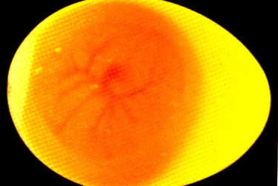
Procedure
1- Candle the egg
Three days aged embryo

Slide 4
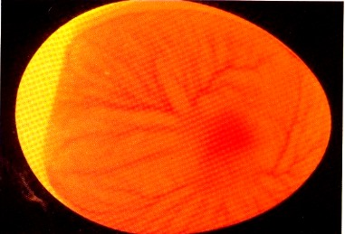
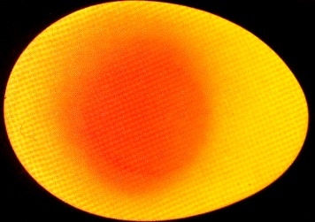
Five days aged embryo
Died embryo

Slide 5
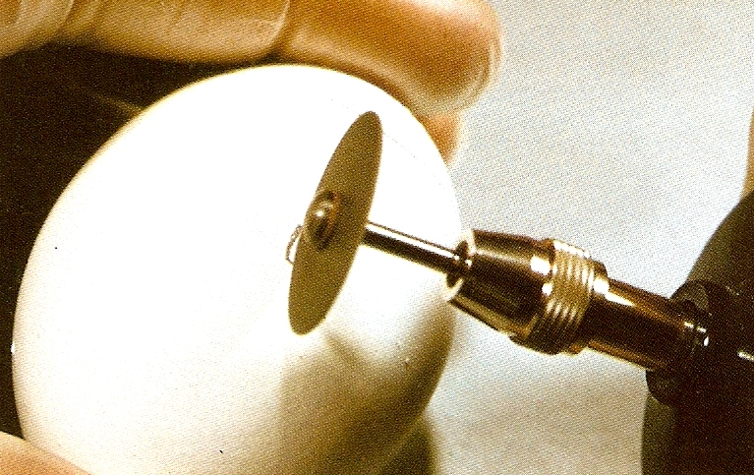
2- Drill a slit in the egg shell

Slide 6
3- Using sterile syringe inoculate 0.1ml of specimen

Slide 7
4- Seal the opening and rotate the egg

Slide 8
5- Incubate the egg at 37C
Incubator
37ºC

Slide 9
6- Harvest the egg looking for pocks on CAM (chorioallantoic membrane)

Slide 10
Recognition
Death of the embryo
Pocks (differentiate between HSV and Pox ,VS, HSV-1 and HSV-2)

Slide 11
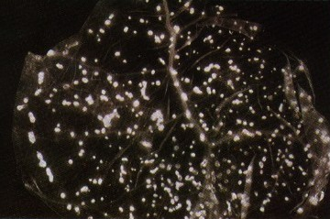
Pocks on CAM (chorioallantoic membrane): chick embryo infected with HSV-1 show pocks on CAM.

Slide 12
Inoculation of clinical sample in Lab animals
Include:
Mice , rabbit , monkey
Used for isolation of
Arbo vs, HSV, Coxsacki A and B

Slide 13
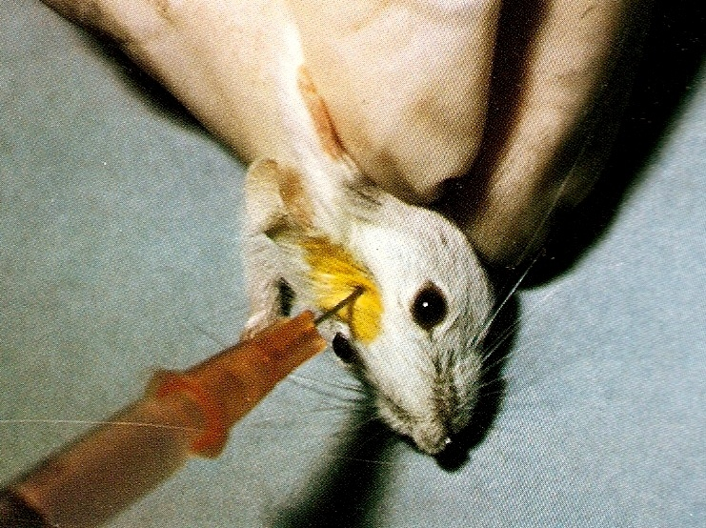
1- Inoculate newborn mice within 24-48 hours of birth using long-needle syringe
Procedure
* Intracerebral

Slide 14
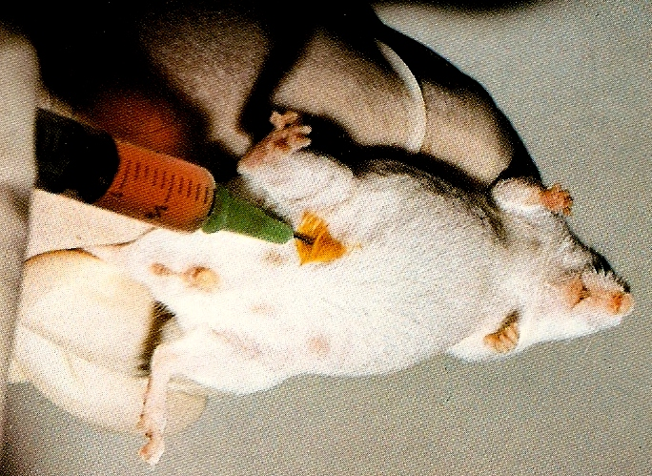
* Intraperitoneal

Slide 15
2- Check inoculated mouse for signs of illness, paralysis, or death.
Flaccid paralysis
Spastic paralysis
Recognition:
Death, paralysis, hemorrhage
Identification:
Immunoassay

Slide 16
Uses of Animal Systems in Virology:
1.When the virus cannot be propagated in vitro
2.To study the pathogenesis of viral infections
3.To study vaccine safety
But Animal Systems are of little use now adays for the following reasons:
1. Expensive and time consuming
2. Whole animal is a complex system
3. Results are not always reproducible due to host variation
4. Virus isolation in animals is inferior to the molecular techniques like PCR.

